Slide 1

Integrated Eligibility Universe GTM
Reduction of Administrative Costs
Mitigation of churn created by case closures
Customer Portal
Worker Portal
Provider Portal
Any web portal used by persons to engage with department services:
Applying for a program or service
Submitting an inquiry about a program or service
Screening for a program or service (income-based child-care)
On-going interactions with a program or service
Any web portal used by persons to access client information or determine eligibility for a program or service OR to evaluate requirements for service licensing:
Accounting or fund allocation
Review of qualifiers for a program or service
Eligibility Determination of a program or service
Case Management Services
Licensing and License renewal
Any web portal used by persons or businesses to register, be evaluated and/or bill for provided services:
Register as a vendor
Screen for vendor eligibility
Complete licensing requirements
Renew licensing requirements
On-going interactions with a program or service
Submit billing for services provided
Take Application or Renewal Information
Take Change Request Information
Language Assistant
Concentrated efforts that make a big impact
Don’t have to wait for huge federal grants
More control over system changes
One solution could set up system for cross-department enhancements
Reduced Development and Delivery Time
Technology keeps pace with growth
Answer Application Questions
Answer Program or Policy Questions
Send Applications or Renewal

Slide 2
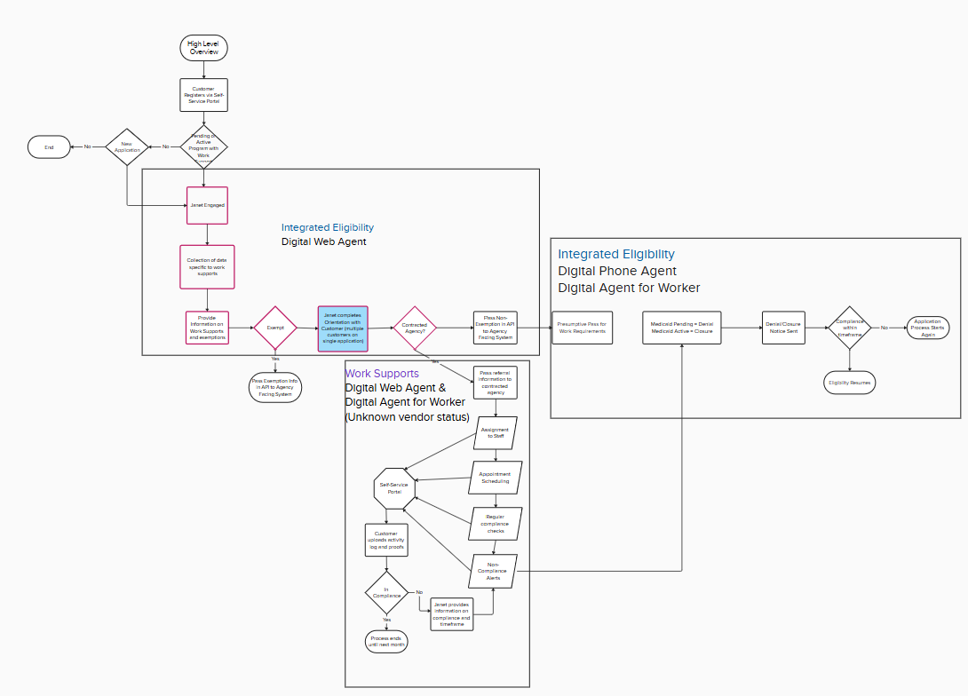
Possible Process Flow
Focus: Work Supports
Medicaid Agency
Based on TANF Work Supports Model
Depending on how intensely the state implements the Work Supports requirement, a Work Supports Vendor may or may not be engaged.

Slide 3
Overview OMNI Channel Agent
Focus: Work Supports
Medicaid Agency
Web Agent (customer)
Web Agent (agency)
Voice Agent (customer)
Applies to web portals used by customers to get information on Medicaid or engage with Medicaid Eligibility:
Information only: Interactive web agent pulls from the most recent Medicaid policy to answer questions on specific Medicaid policy.
Used during anonymous browsing or logged into the application
Information plus: Interactive web agent uses information gathered during question chat to populate web application if customer proceeds
Used during completion of the application for help understanding questions, why a question is relevant and how the answer is used to determine benefits
Decision making: Collects additional information based on programs applied for. Does preliminary screening for Work Supports. If work supports is a requirement:
Completes Orientation
API Referral to Work Supports
Work Supports information to agency
Applies to web portals used by Agency Workers in determining Eligibility:
Information only: Interactive web agent pulls from the most recent Medicaid policy to answer questions on specific Medicaid policy.
Used during processing applications/renewal/case management
Information plus: Interactive web agent uses information gathered during questions to provide policy specific to the case details by asking follow-up questions about household.
Used when determining eligibility or when answering customer questions about programs and policies.
Update: Evaluates information collected, connects with OCR document scanner to populate data fields, makes suggestions to workers based on policy and program for additional information, updates verification codes for notice readouts, highlights discrepancies.
Used during application and redetermination.
Used with IVR system to handle first and second level calls:
Information only: Interactive web agent pulls from the most recent Medicaid policy to answer questions on specific Medicaid policy.
Screens customers calling about policy information or information provided by API
Information plus: Interactive voice agent uses information gathered during conversation to make updates to a case, like entering a new address. Updates conveyed back to the Agency Portal by API.
Provide help understanding application and renewal questions.
Update: Collects additional information based on data discrepancies. Does preliminary screening for Work Supports. If work supports is a requirement:
Completes Orientation
API Referral to Work Supports
Work Supports information to agency
Thomas: What is the difference in cost if we use this for work supports or for all of IE?
Recommendation: Combine Call Center Numbers for Eligibility Programs

Slide 4
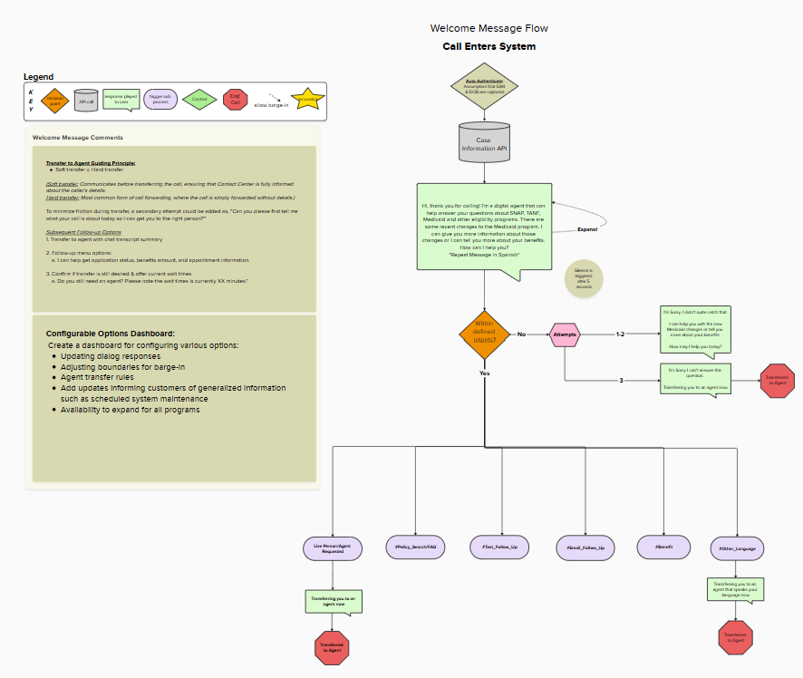
Script: Voice Agent
Focus: Work Supports
Medicaid Agency
Voice Agent Scripting

Slide 5
Script: Voice Agent
Focus: Work Supports
Medicaid Agency
Scenario: Caller contacts agency call center, Voice Agent provides information on Medicaid changes
Voice Agent Scripting
Voice Agent: Hi, thank you for calling! I’m a digital agent that can help answer your questions about SNAP, TANF, Medicaid and other eligibility programs. There are some recent changes to the Medicaid program. I can give you more information about those changes or I can tell you more about your benefits. How can I help you?
*Repeat Message in Spanish*
Allow for interruption starting during Spanish message
Customer: Umm Medicaid changes, what are you talking about?
Voice Agent: There have been recent changes to Medicaid, that could affect your health care benefits. Am I talking to Jason?
Customer: Yea, this is Jason. What changes?
Voice Agent: Because you fall between the ages of 19 and 64, you will need to complete a renewal for health care every six months instead of every year. The other big change for you is called community engagement. It means that in order to remain eligible for health care, you have to be involved in a qualified activity for 80 hours a month.
Customer: I don’t understand, what does qualified activity mean?
Voice Agent: A qualified activity just means that you need to be working, volunteering, going to school for at least 80 hours a month. At renewal you will need to provide verification to remain eligible for health care.
Customer: I don’t really get it, like what kind of verification.
Voice Agent: For verification you can provide a pay stub, or timesheet, a statement from your teacher or the place you volunteer with. Changes like this can be overwhelming. I can provide information to you by text or email if that would be helpful.
Customer: yeah can you text that to me
Voice Agent: Sure! I have 000 000 0000 as your phone number, is that still correct?
Customer: No, that was like three numbers ago, my number is 111 111 1111
Voice Agent: Ok Great! I just sent you a summary message, did you get it?
Customer: yeah, I see a new text came in
Voice Agent: Look over the information when you have a chance, you can reply to the text if you need more information
Customer: What? Like I can just text to ask you questions?
Voice Agent: Sure! But just so you know, I’m only able to give you general information over text, not anything specific to your benefits in order to protect your privacy. For questions specific to your benefits you can log into your account and chat with me there or call the call center and we can chat. Would it be helpful if I sent you a reminder about your renewal and the verifications you need to provide? I can do it by text or by email.
Customer: Yeah that would be cool if you sent me a text
Voice Agent: Got it, what else can I help you with?
Customer: I think I’m good. Thanks
Voice Agent: Have a great day

Slide 6
Script: Web Agent
Focus: Work Supports
Medicaid Agency
Scenario: Agency Worker is processing a new Medicaid application and has questions on the Community Support requirements
Agency Chat Agent Scripting
Chat Agent: Hi, how can I help you?
*Repeat Message in Spanish*
Agency Worker: How do I know if this person is in the community supports category?
Chat Agent: The first thing we will do is check to see if they are considered part of the expansion population. How many people are part of the assistance unit?
Agency Worker: Assistance unit? I don't know what that is
Chat Agent: An assistance unit is the people in the household that are considered as a group for eligibility. Typically people who are in the same tax reporting household are an assistance unit. Does that clarify things?
Agency Worker: Oh ok, yeah. There are three people in the assistance unit
Chat Agent: Three people in the assistance unit need to have a combined income of $3,065 or below.
Agency Worker: I don’t really get it, like what kind of verification.
Chat Agent: For verification you can provide a pay stub, or timesheet, a statement from your teacher or the place you volunteer with. Changes like this can be overwhelming. I can provide information to you by text or email if that would be helpful.
Agency Worker: yeah can you text that to me
Chat Agent: Sure! I have 000 000 0000 as your phone number, is that still correct?
Agency Worker: No, that was like three numbers ago, my number is 111 111 1111
Chat Agent: Ok Great! I just sent you a summary message, did you get it?
Agency Worker: yeah, I see a new text came in
Chat Agent: Look over the information when you have a chance, you can reply to the text if you need more information
Agency Worker: What? Like I can just text to ask you questions?
Chat Agent: Sure! But just so you know, I’m only able to give you general information over text, not anything specific to your benefits in order to protect your privacy. For questions specific to your benefits you can log into your account and chat with me there or call the call center and we can chat. Would it be helpful if I sent you a reminder about your renewal and the verifications you need to provide? I can do it by text or by email.
Agency Worker: Yeah that would be cool if you sent me a text
Chat Agent: Got it, what else can I help you with?
Agency Worker: I think I’m good. Thanks
Chat Agent: Have a great day

Slide 7
Script: Voice Agent
Focus: Work Supports
Medicaid Agency
Voice Agent Scripting
Simple member engagement approach
Consolidate call center to one number
Use case: Community Engagement
Member calls, AI voice interaction
AI identifies call intent submit CE docs
AI verifies caller identity
AI texts link for caller to submit CE docs
AI confirms receipt, processes doc
AI summarizes doc contents to caller
AI closes the call with next steps
Data routed to eligibility team
AI assists eligibility team with review
Eligibility team finalizes determination
AI confirms determination with caller over text and provides any next steps

